Slide 1
JOB-AMIGO A Complete Job Portal By
Kommineni Siva Krishna
Thallapalli Ravisha
Bandaru Sarath Chandra
Yempalla Suresh Reddy

Slide 2
Motivation/Objective
Increasing rate of unemployment all over the world.
To Develop a native Mobile app which is a complete job portal.
It is used for searching the jobs for the job seekers based on various criteria's.
The Motivation behind our project is BIGAPPS NYC
http://bigapps2014.splashthat.com/
Developed using existing API’S and own Web Services later parsing them using XML/JSON parsers.

Slide 3
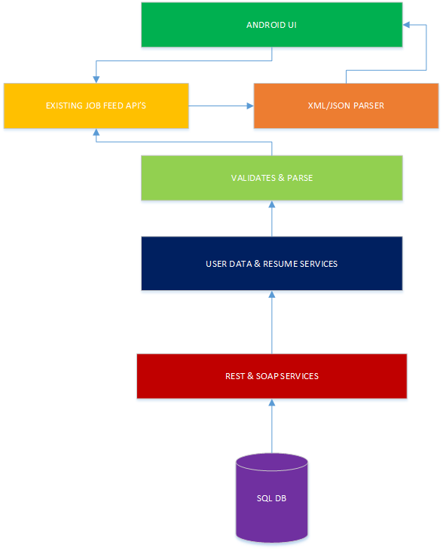
System Architecture:

Slide 4
P.S
This work was done in partial fulfillment of the requirements of :
CS551: Advanced Software Engineering,
CSEE Department, University of Missouri – Kansas City (Fall 2014).
Instructor: Dr. Yugyung Lee
TA: Malathy Krishnan

